Slide 1
DOE Collegiate Wind Competition ‘19 - Electrical Design
Team Turbine Electric
4/26/19
Abdallah Alsharrah Juntong Liu
Chris Taylor

Slide 2
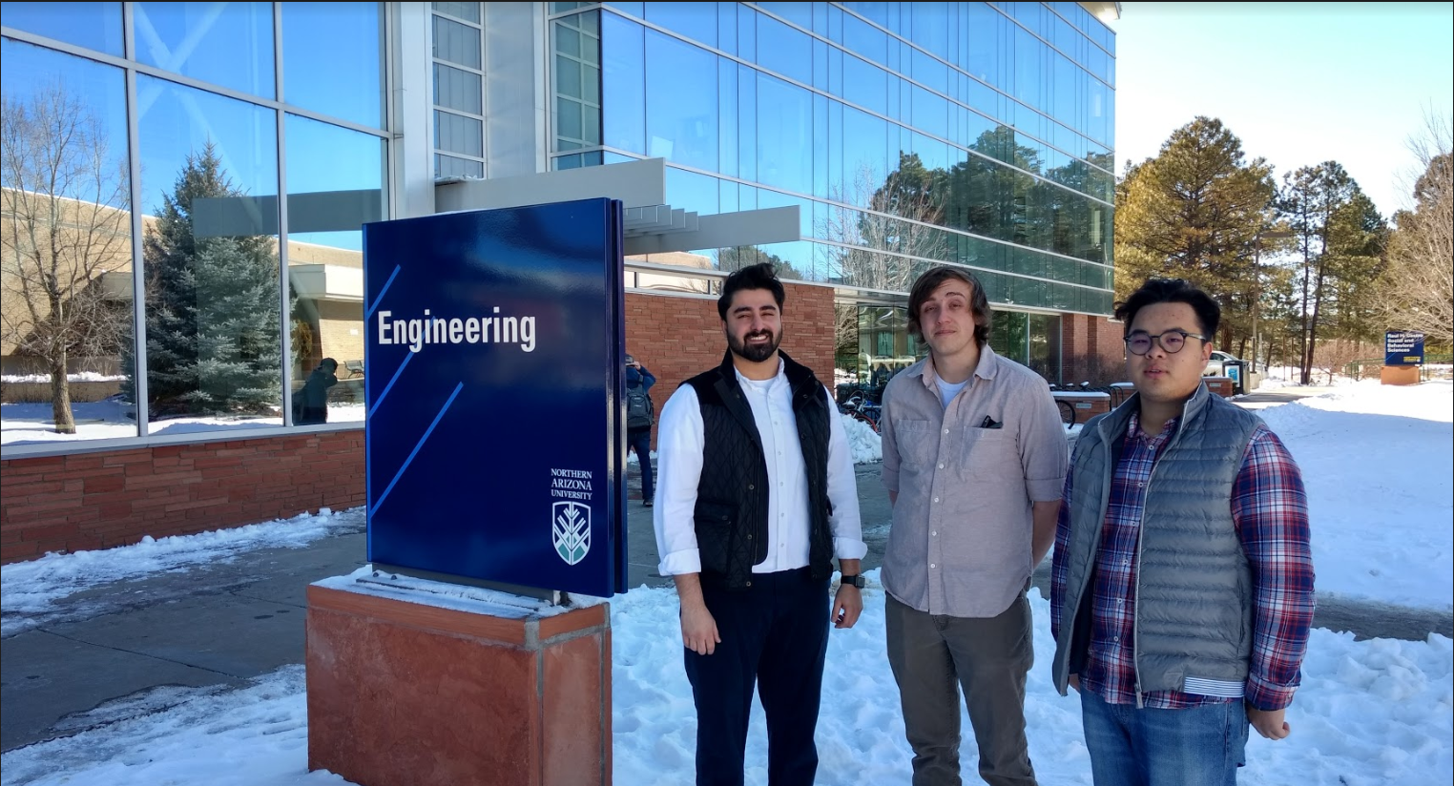
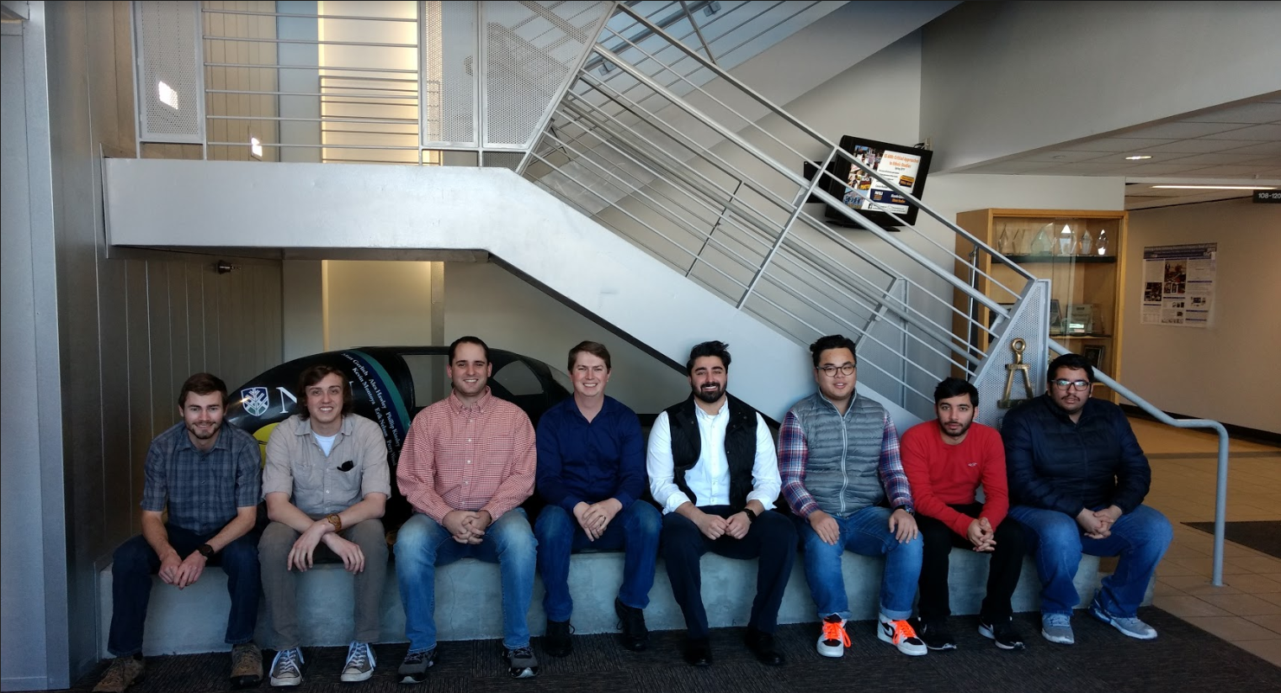
Team Introduction
We are Team Turbine Electric of the DOE Collegiate Wind Competition.
(Picture of Team Turbine Electric)
(Picture of both EE team and ME team)
Juntong

Slide 3

Project Introduction
U.S. Department of Energy is the sponsor
Collegiate Wind Competition
    Competition hold in Boulder, Co. May 6th-9th.
    Sixth team representing NAU at the competition.
Combined design by both electrical and mechanical engineering majors.
Our task is to cover the design, building, and testing of a wind turbine.
    AC/DC rectifier
    DC/DC buck-boost converter
    DC/DC boost converter
    Combine and test with a wind turbine
Juntong

Slide 4
Client Requirements
Clients: David Willy, Venkata Yaramasu
Compact & Portable design
Capable of competing in all aspects of the competition
Backup Systems
Modularity for Components
Neat Organization of Wires and Components
Juntong

Slide 5
Engineering Requirements
No excessively large capacitors.
No Batteries of any type.
Independent ground needed on turbine can’t be tied to other components.
Turbine components may draw from the load but must register a zero state of charge at beginning of test.
Must maintain a constant voltage.
Wind speeds between 5 & 11 m/s inclusive maximum duration of 60 seconds or less.
Must withstand a maximum wind speed of 20 m/s
Juntong

Slide 6
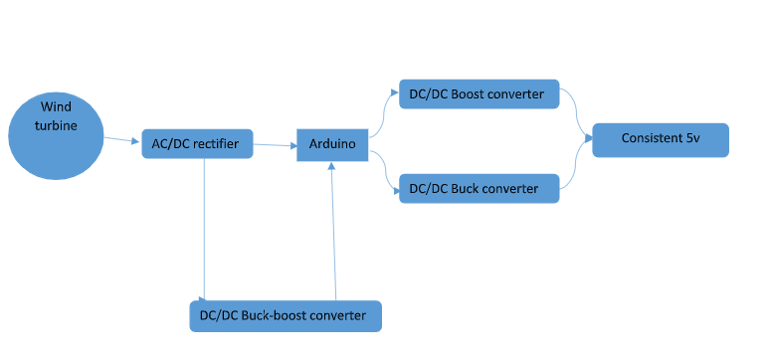
Design Overview
Chris

Slide 7
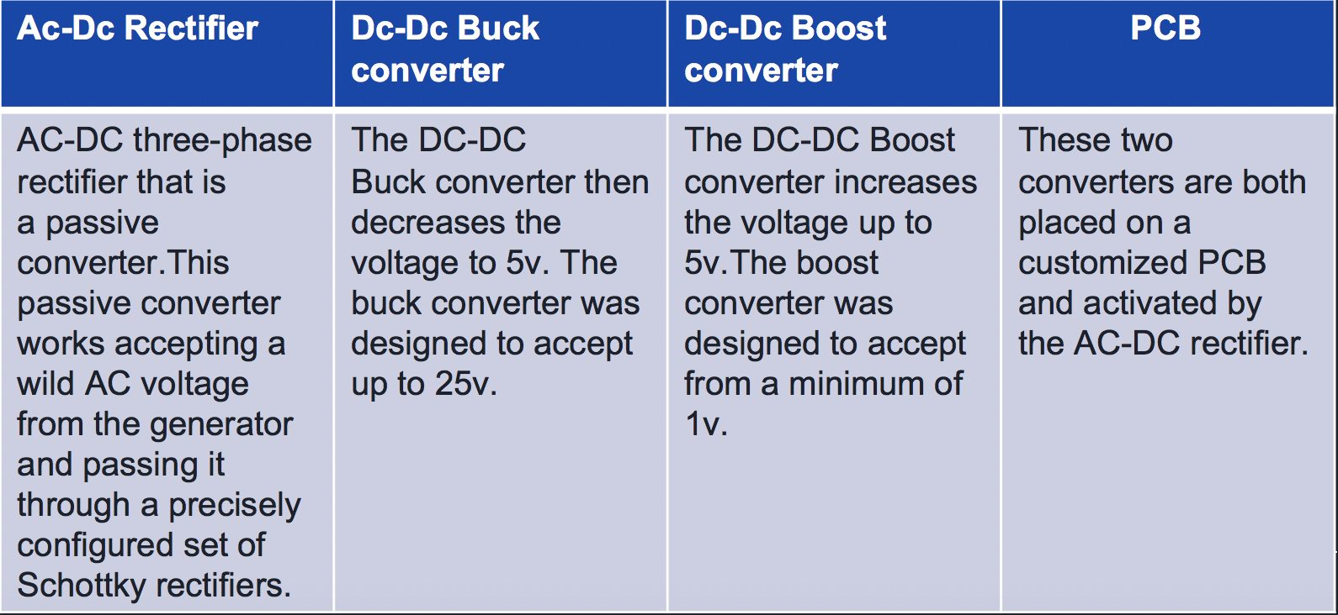
Design Overview
Chrisdsa

Slide 8
Subsystems
AC-DC Rectifier
  Device that changes alternating current flow (AC) to direct current flow (DC)
DC-DC Buck Converter
  A kind of DC converter that has a reduced output voltage
DC-DC Boost Converter
  Produces an output voltage which is greater than the source voltage
Chris

Slide 9
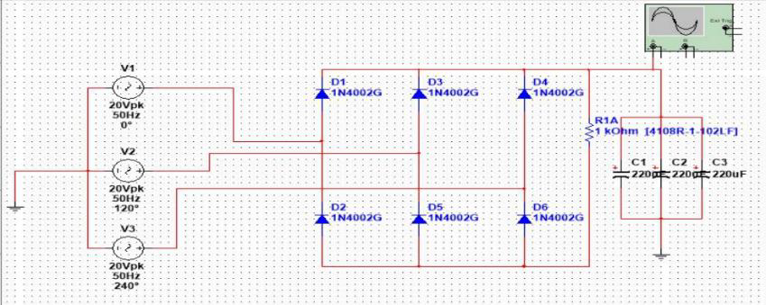
AC-DC Rectifier - Design Process
Schematics
Part Ordering
Breadboard Testing
Perfboard Soldering
Chris

Slide 10
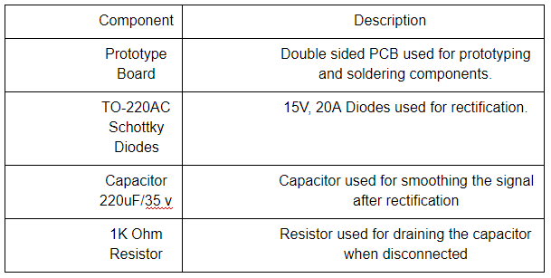
AC-DC Rectifier - Construction Process
Components: 330uF Capacitor, 6 Schottky Diodes, 2k Ohm Resistor
Chris

Slide 11
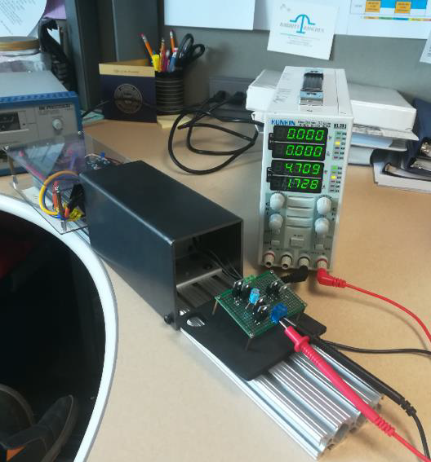
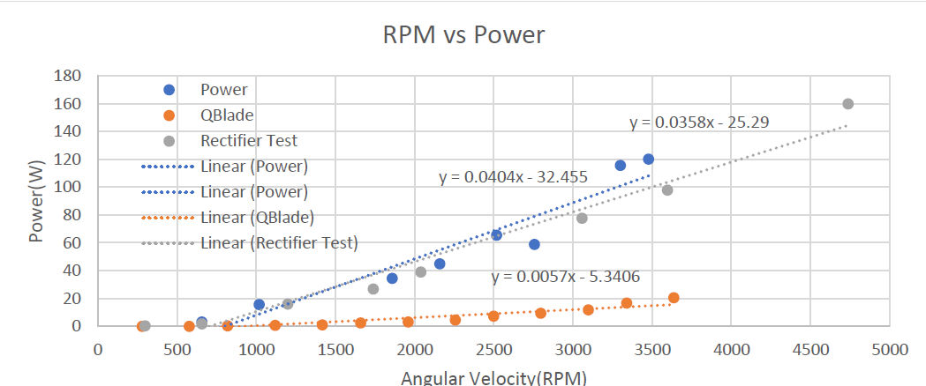
AC-DC Rectifier - Testing Process
The rectifier was tested on both an open and closed circuit by using a dynamometer. The open circuit test determined the maximum voltage expected while the closed circuit helped verify that the components could maintain functionality with increased amperage.
Chris

Slide 12
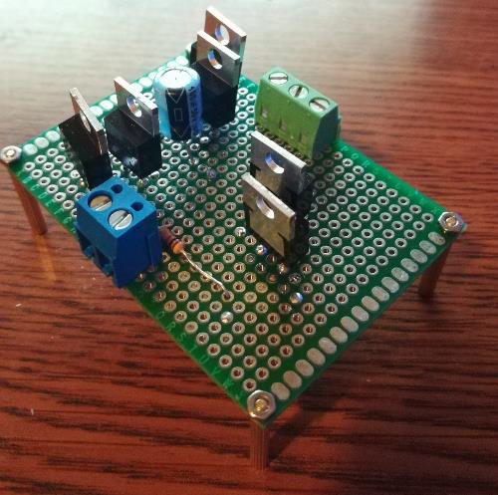
AC-DC Rectifier - Final Design
Passive Cooling
Consistent Output
Compact Design
Chris

Slide 13
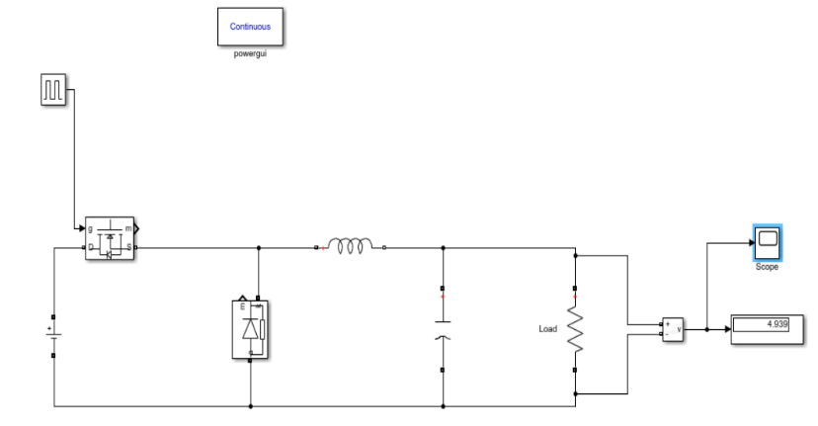
DC-DC Buck Converter - Design Process
Schematics
Part Ordering
Breadboard Testing
Perfboard Soldering
Abdallah

Slide 14
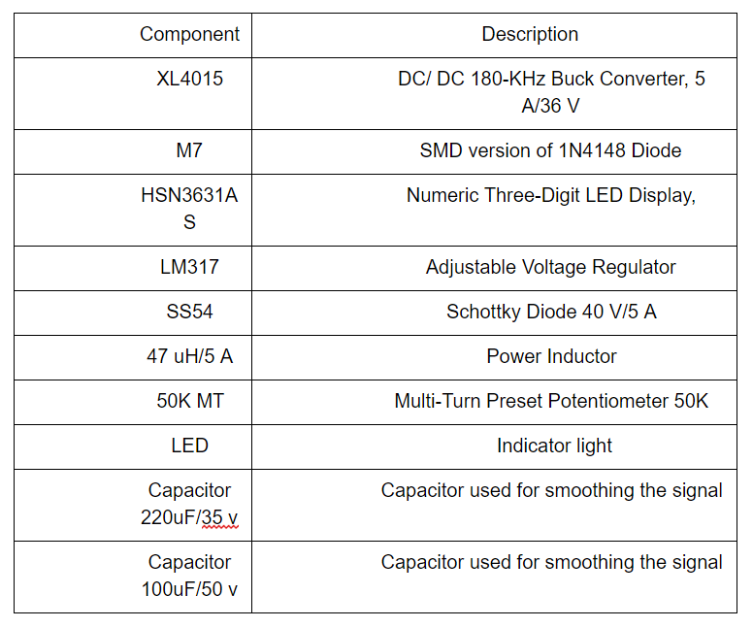
DC-DC Buck Converter - Construction Process
Breadboard Testing
PerfBoard Soldering
PCB Schematic
PCB Testing
Full Design Integration
Abdallah

Slide 15
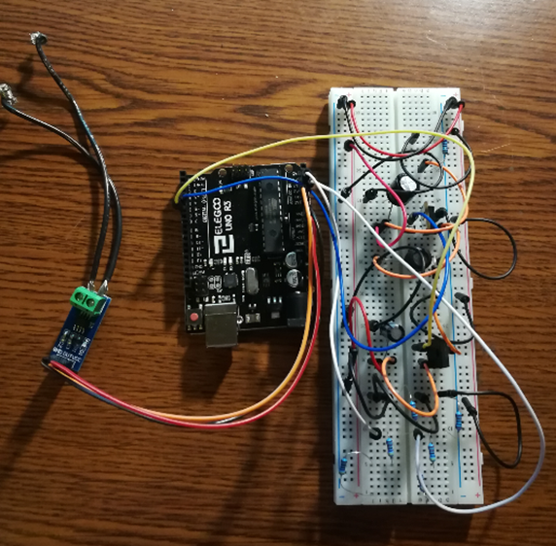
DC-DC Buck Converter - Testing Process
The buck converter components were tested on a breadboard with low voltage and current to verify the output voltage was less than the input voltage. The components were then soldered onto a PCB for full scale testing.
Abdallah

Slide 16
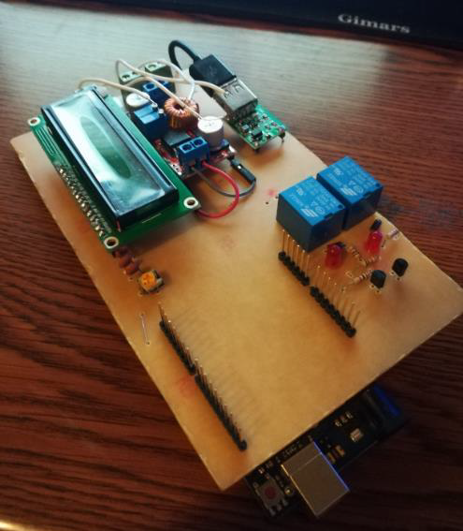
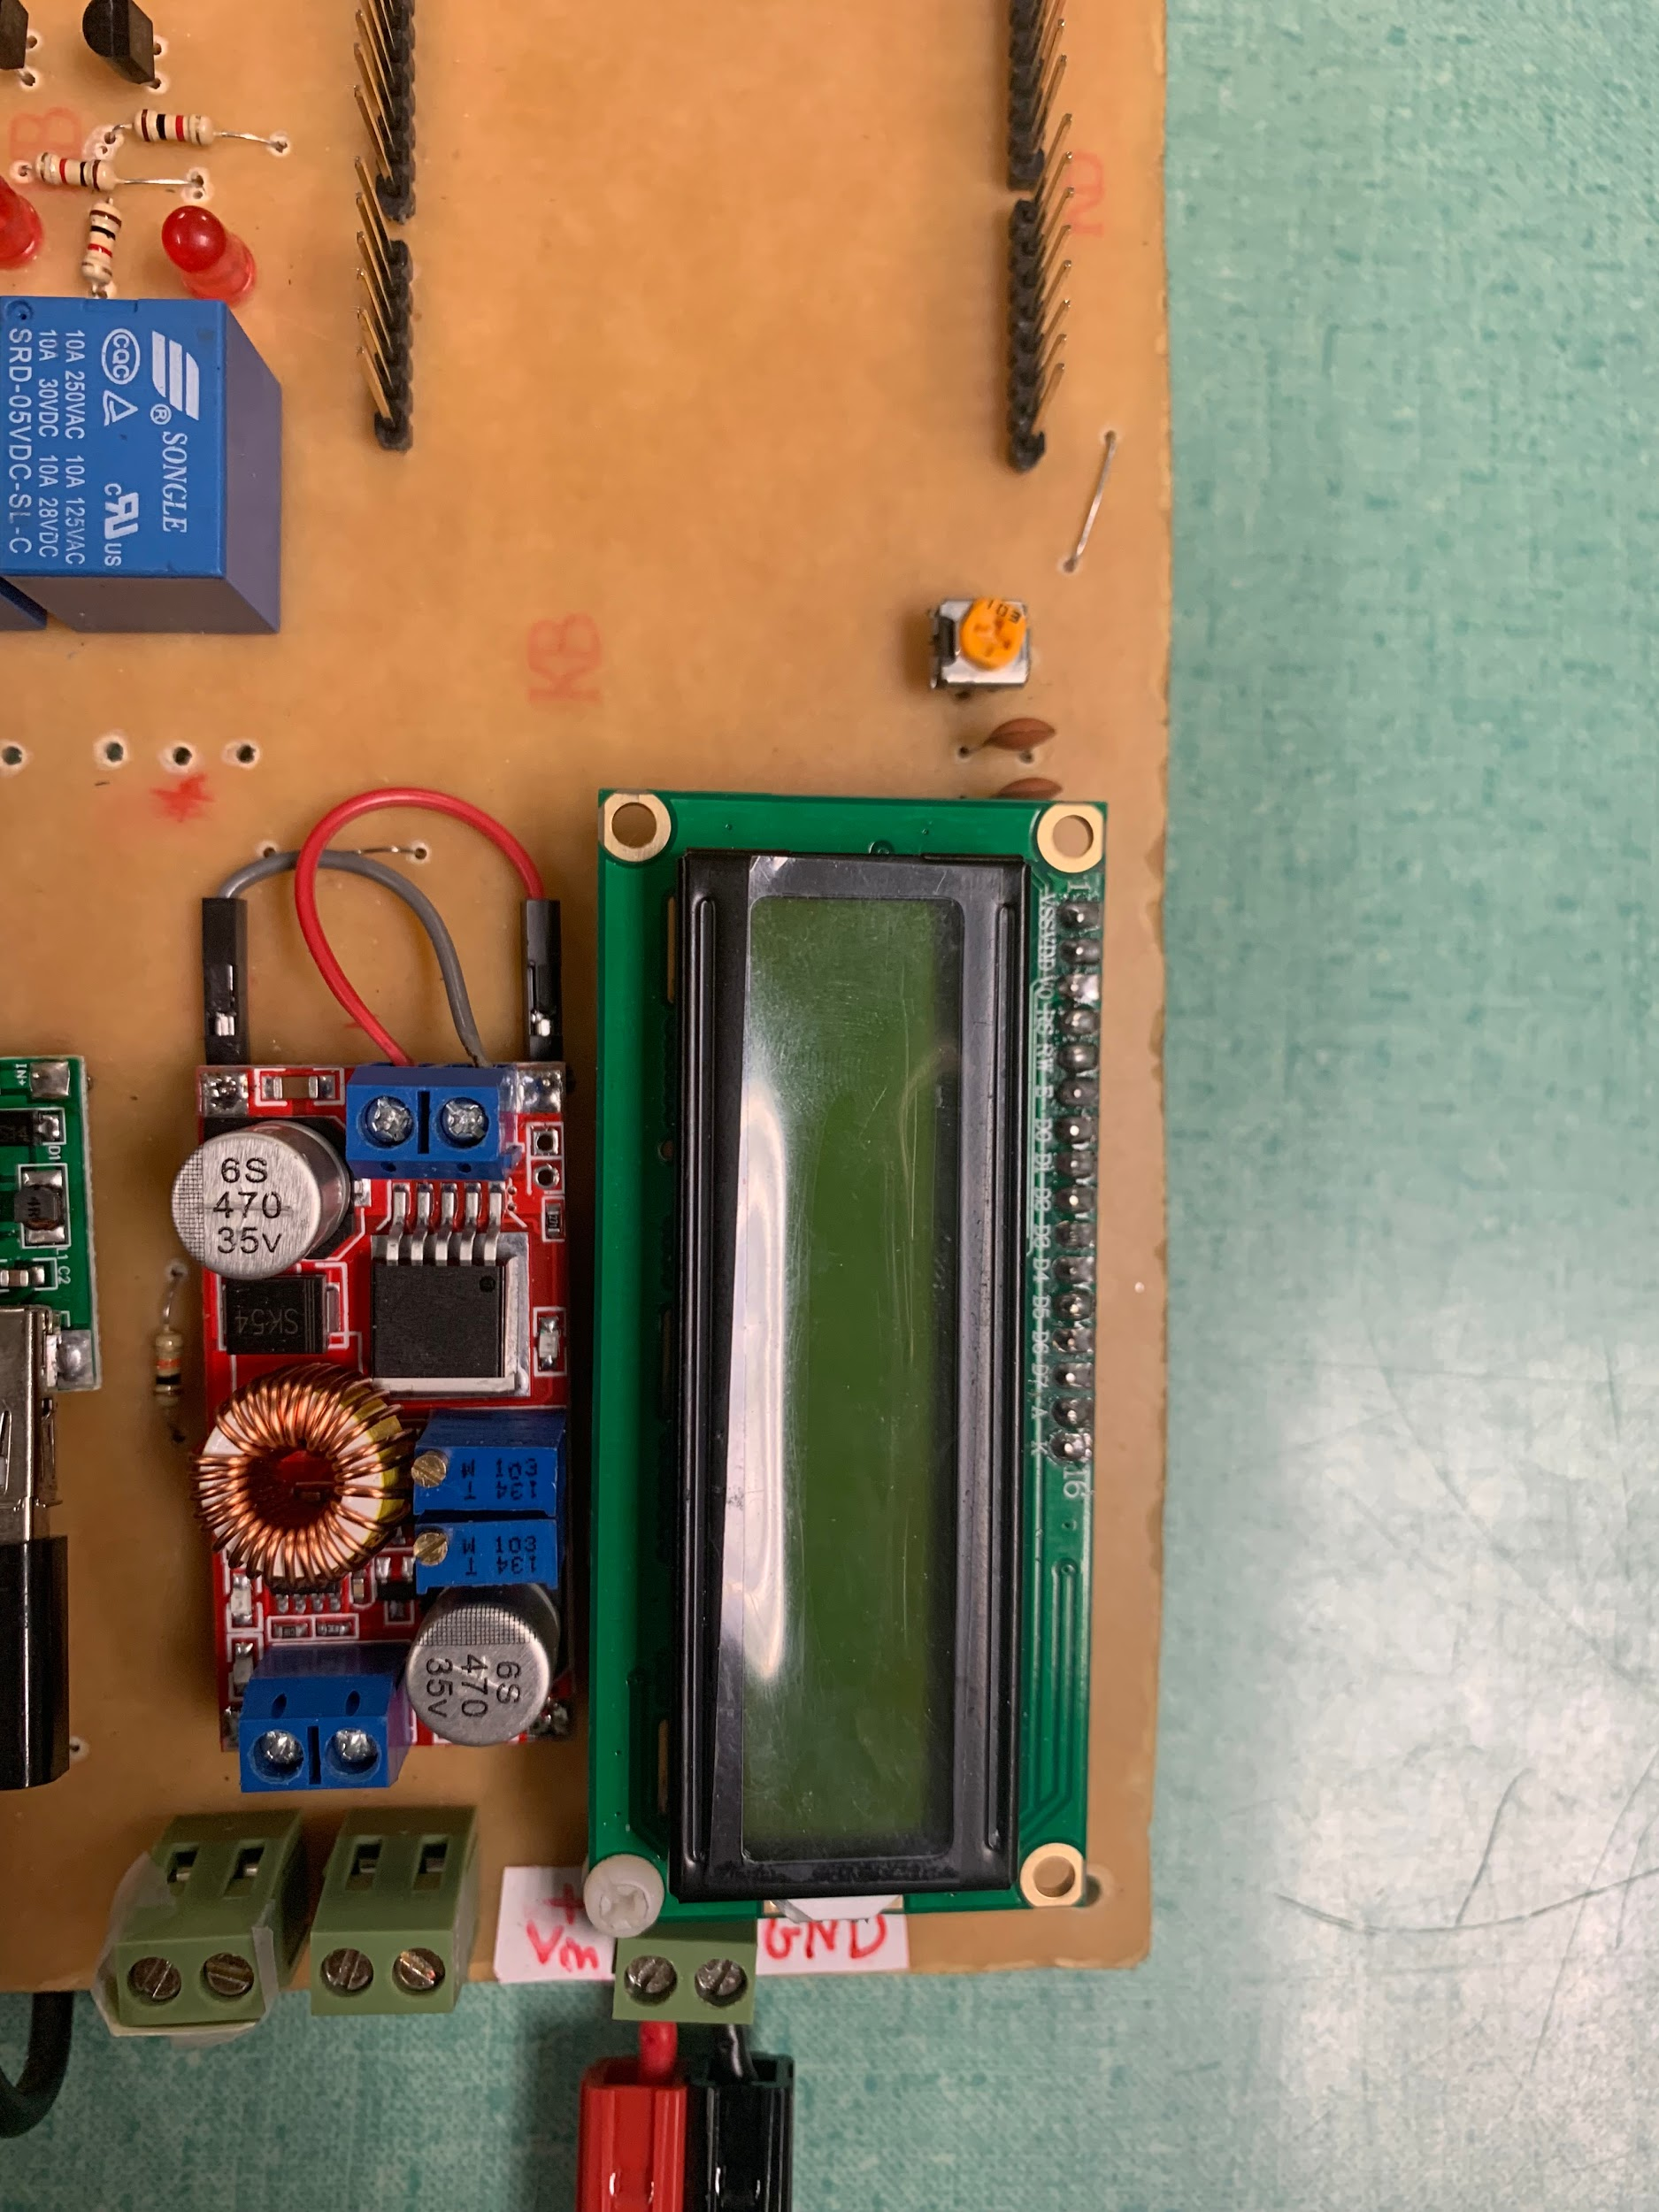
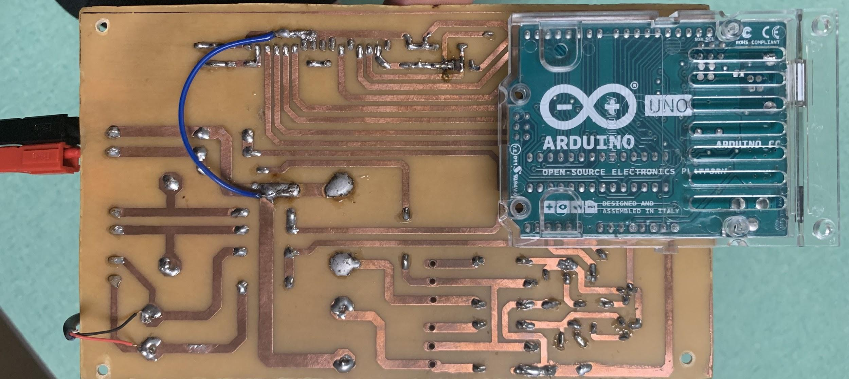
DC-DC Buck Converter - Final Design
The DC-DC Buck Converter is placed on a customized PCB and controlled by the Arduino which switches the relay to buck mode for the stepping down of the voltage.
Abdallah

Slide 17
DC-DC Boost Converter - Design Process
Schematics
Part Ordering
Breadboard Testing
Perfboard Soldering
Abdallah

Slide 18
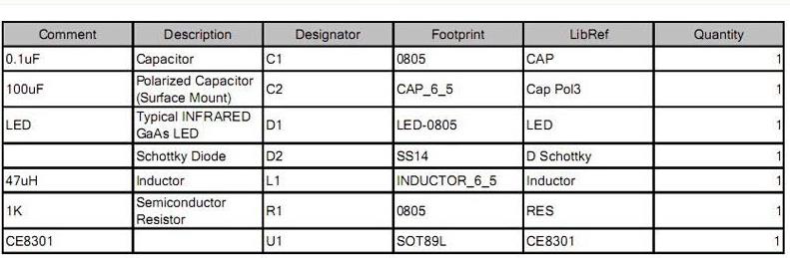
DC-DC Boost Converter - Construction Process
Breadboard Testing
Perfboard Soldering
PCB Schematic
PCB Testing
Full Design Integration
Abdallah

Slide 19
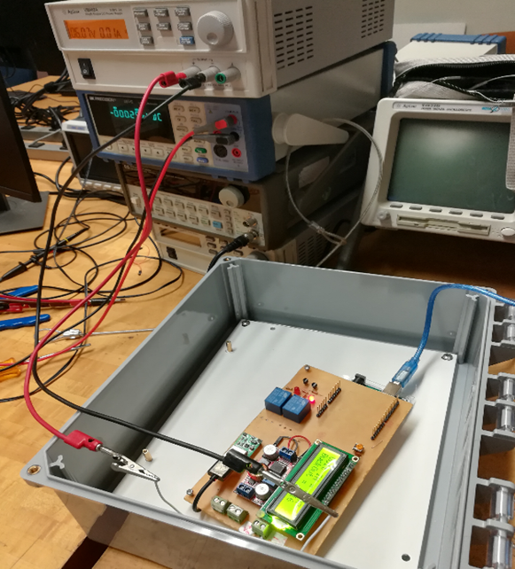
DC-DC Boost Converter - Testing Process
The components for the boost converter were first tested using a breadboard with low input voltage. The Arduino was used to measure the output voltage and adjust the duty cycle depending on the input voltage. The components were then soldered onto a perf board for higher voltage testing.
Abdallah

Slide 20
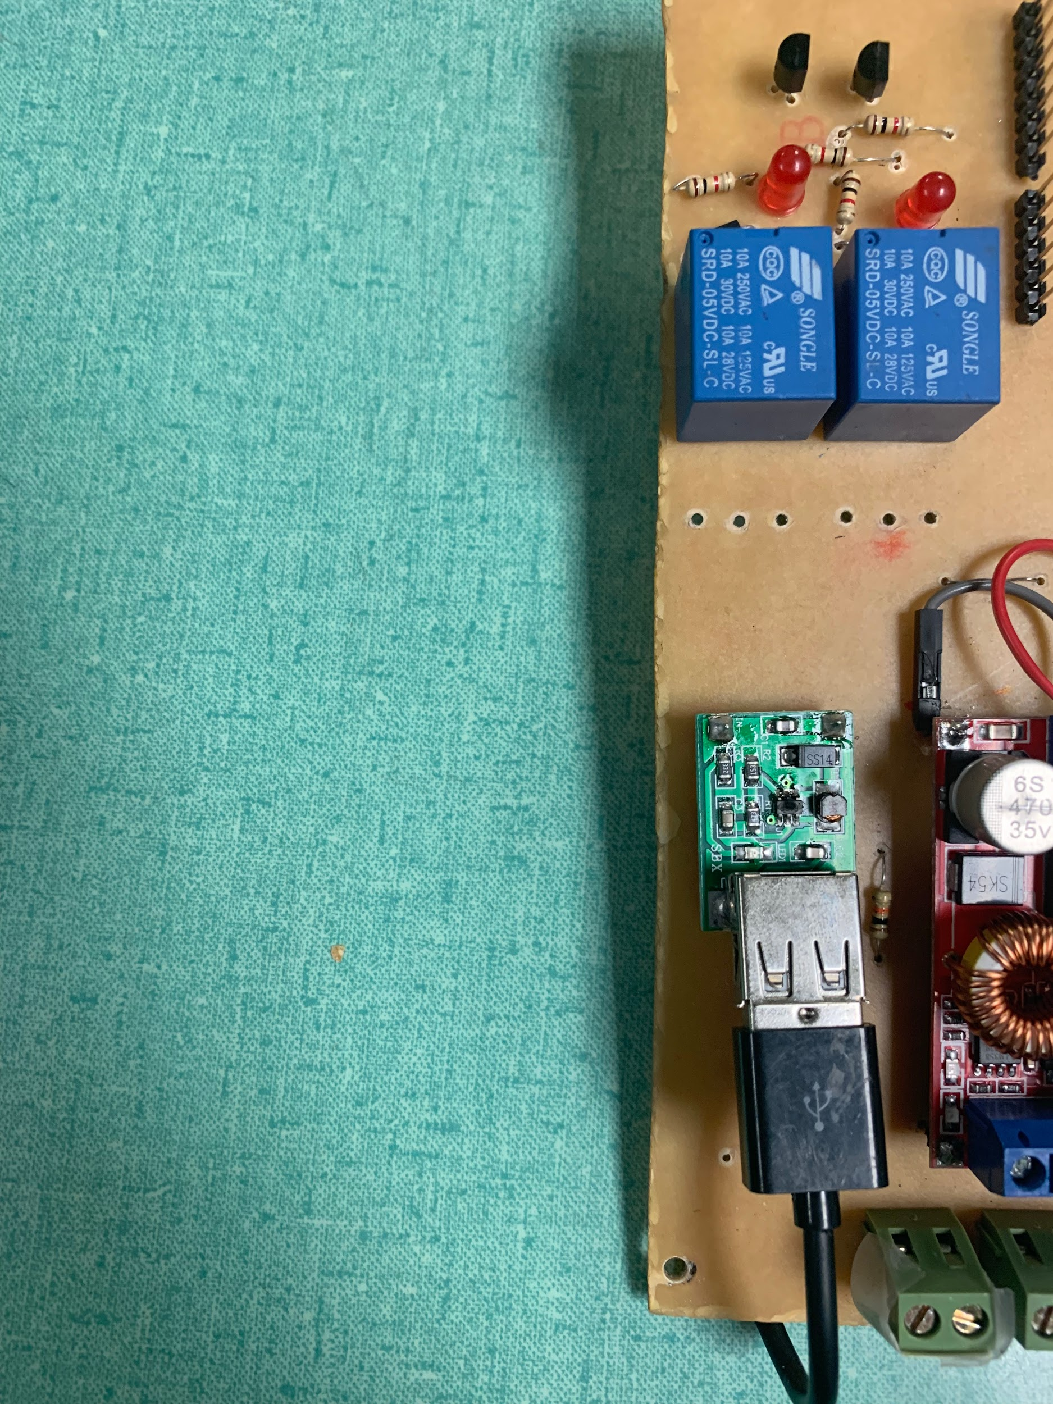
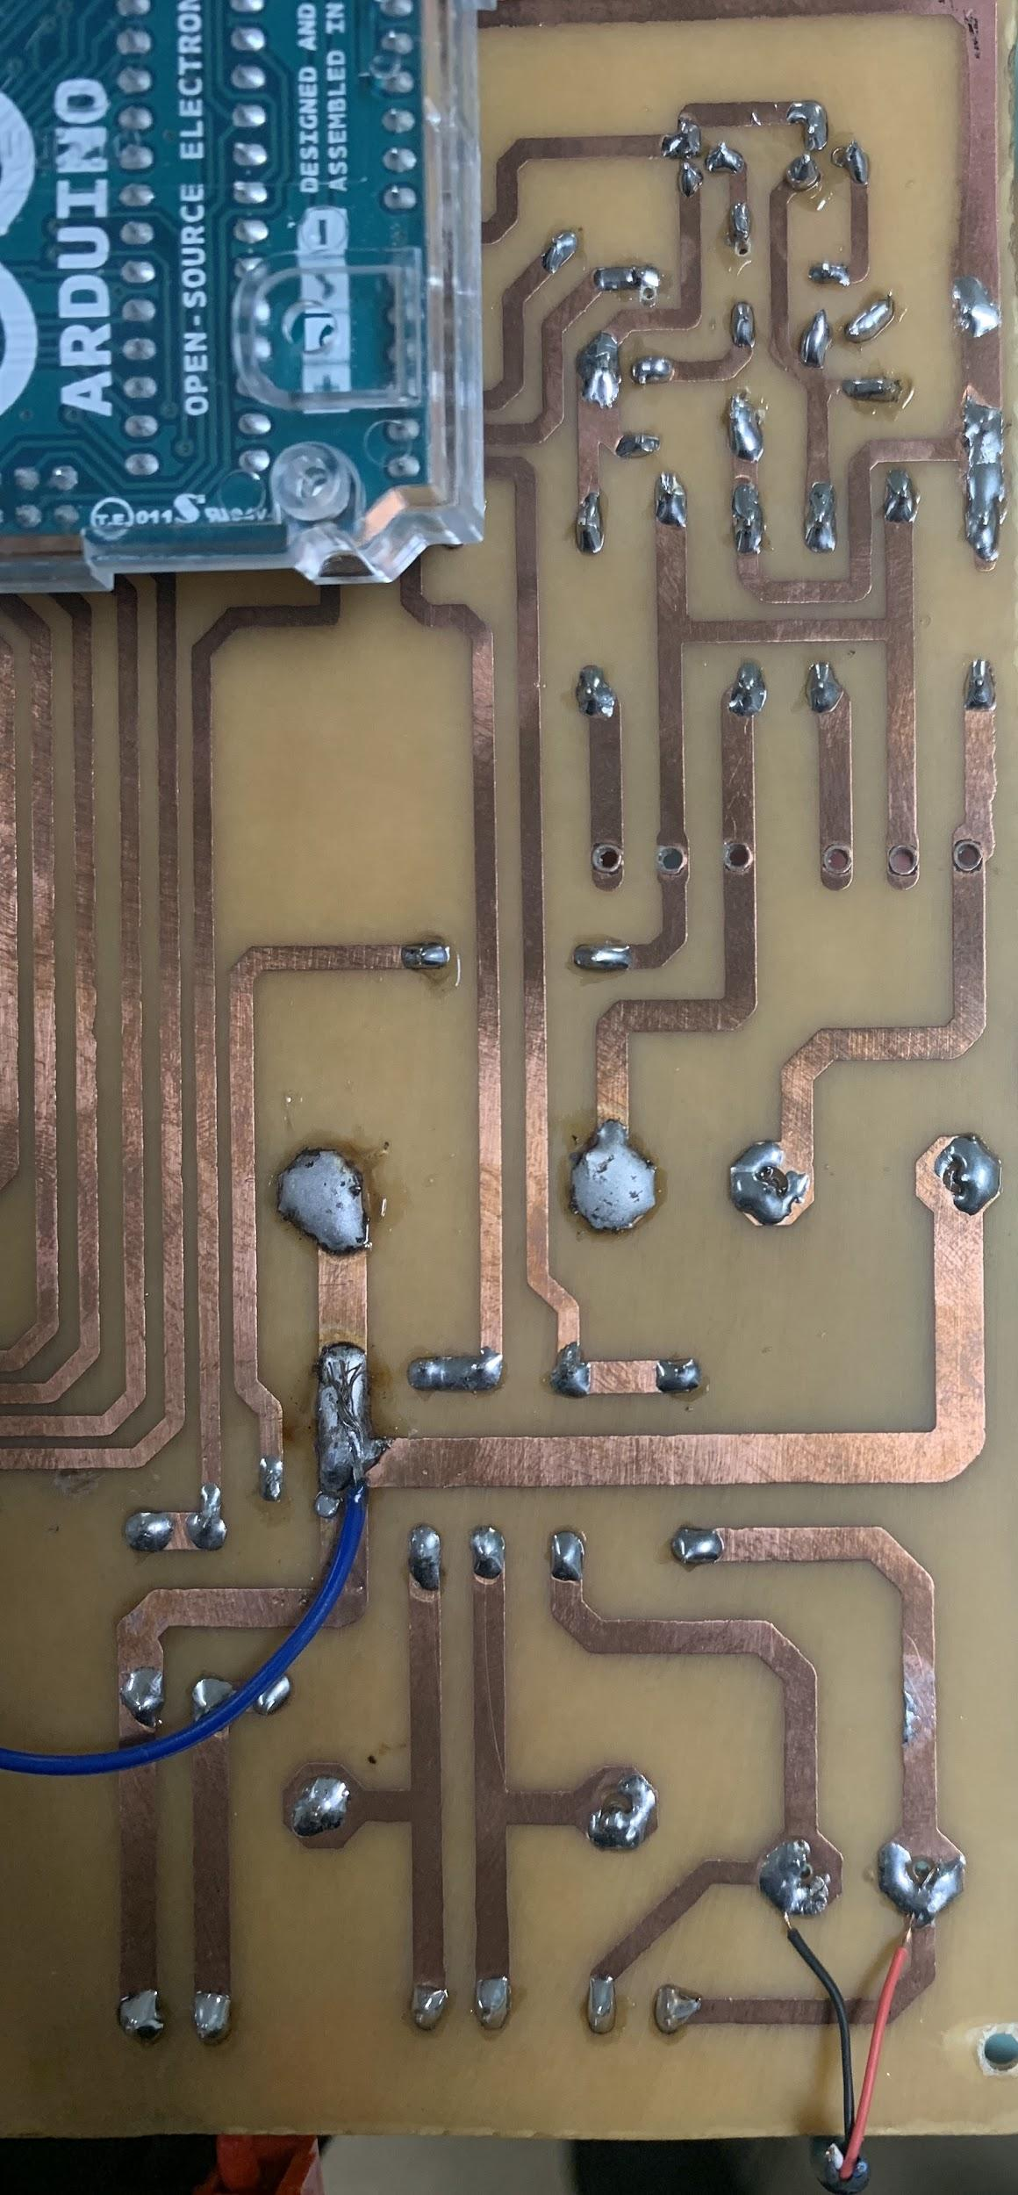
DC-DC Boost Converter - Final Design
The DC-DC Boost Converter is placed on a customized PCB and controlled by the Arduino which switches the relay to boost mode for the stepping up of the voltage.
Abdallah

Slide 21
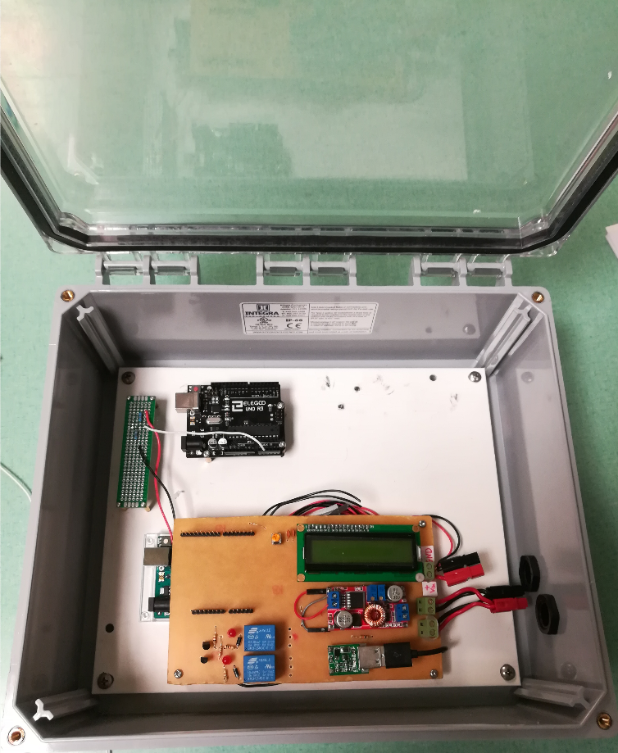
Electronics Enclosure
NEMA 3 Enclosure
Subpanel for easy removal
Housing for all electrical components
Chris

Slide 22
Thank you to...
Professor Willy, Dr. Yaramasu, Dr. Winfree, Han Peng
The DOE for hosting the competition.

Slide 23
Questions?

